Slide 1
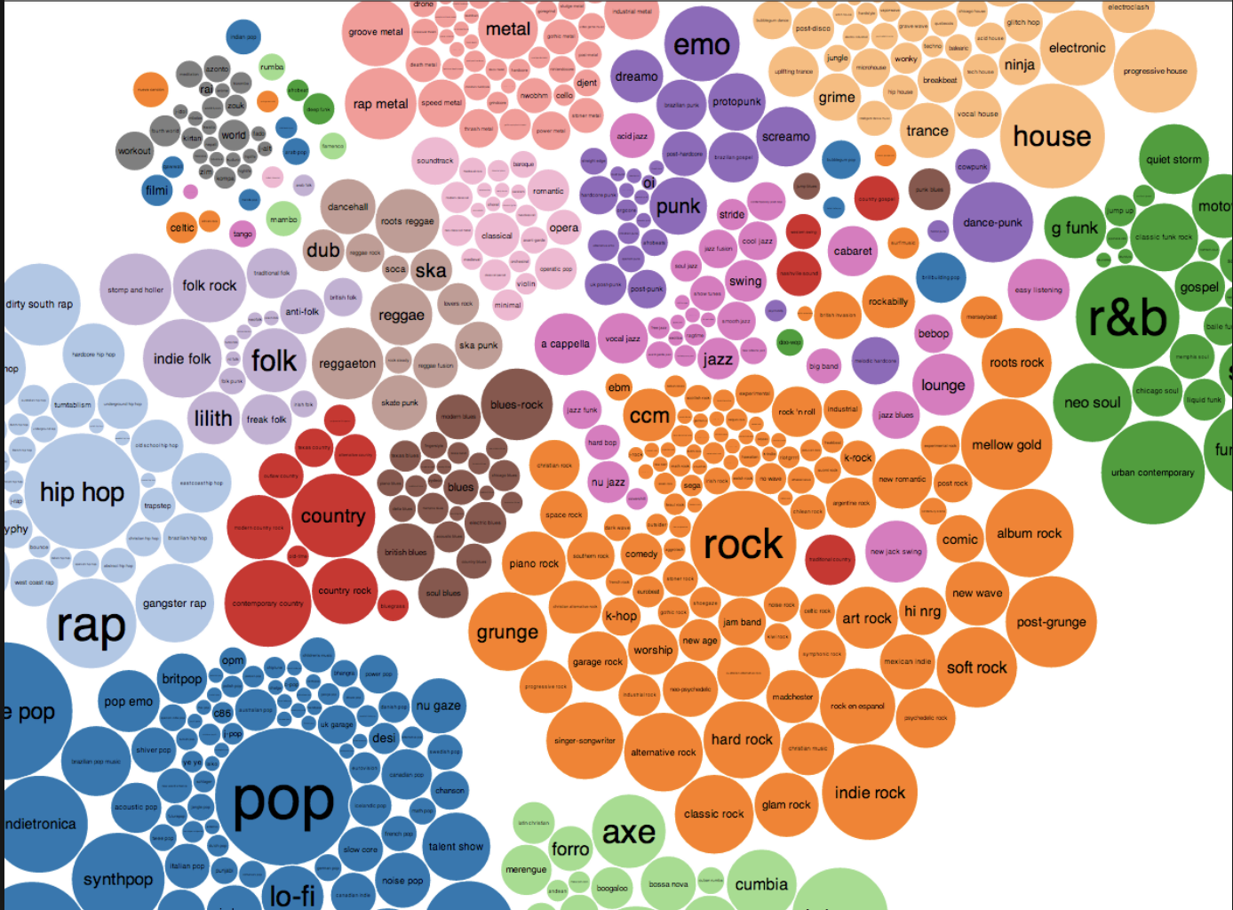
Music Genre Classification
Shivani Soman

Slide 2
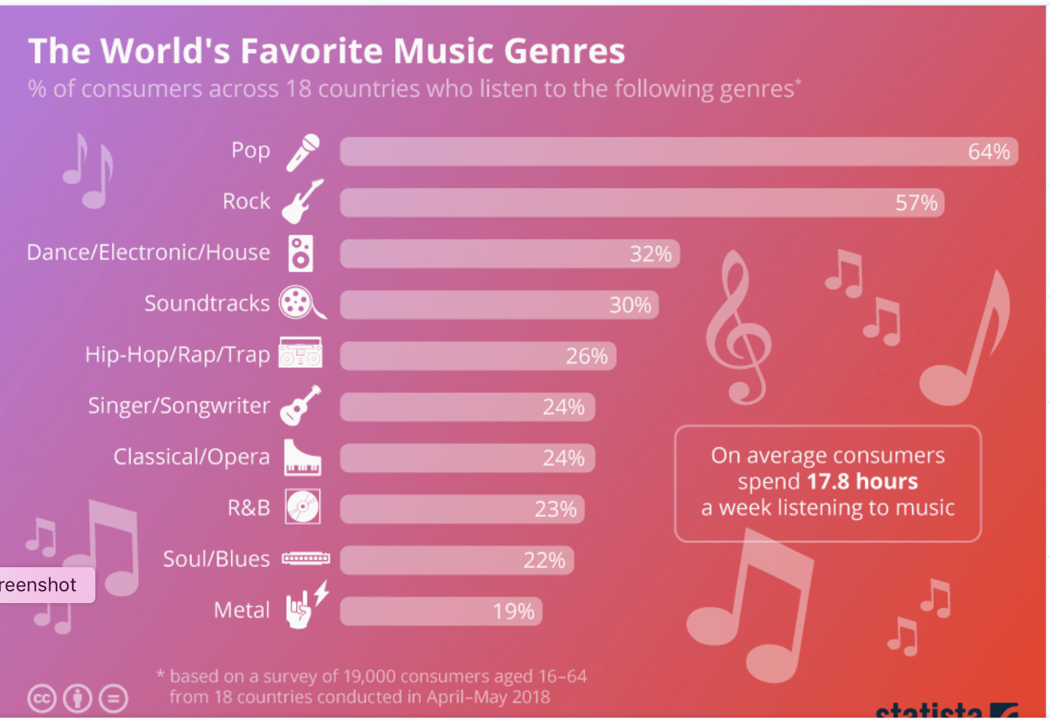
Introduction
Categorizing music into different groups based on similarities in style, tempo, rhythm or melody
Over 1200 micro-genres of music exist
Humans can almost instantaneously recognize music genre
More likely to search music by filtering through genre
Automatic recommendations, organizing libraries for faster access

Slide 3
Dataset
GTZAN Genre Collection - 1.2 gb
1000 audio tracks each 30 seconds long
10 genres each represented by 100 tracks
22050Hz Mono 16-bit audio files in .wav format
Files were collected in 2000-2001 from a variety of sources including personal CDs, radio, microphone recordings, in order to represent a variety of recording conditions
Genres included - Blues, Classical, Country, Disco, HipHop, Jazz, Metal, Pop, Reggae, Rock

Slide 4
Proposed Solution
Spectrogram Analysis
Convolutional Recurrent Neural Network
Input Data
Temporal and spectral features extraction
Machine Learning Classifiers

Slide 5
Method I - Temporal and Spectral Feature Extraction
Temporal Features - Zero Crossing Rate, Root Mean Squared Energy
Spectral Features - Centroids, Bandwidths, Contrast, Roll-off, Mel-frequency cepstral coefficients (MFCCs), Chroma Features
All features extracted using LibROSA - python library for audio and music analysis
Mean, Std
Machine Learning Algorithms - KNN, Logistic Regression, Random Forest, XGBoost

Slide 6
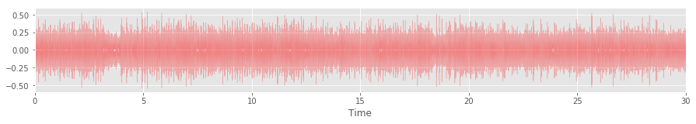
Temporal Features
Basic Features - mean, standard deviation, skewness, kurtosis
Zero Crossing Rate - rate of sign-changes along a signal, i.e., the rate at which the signal changes from positive to negative or back.
Tempo - beats per minute of the music sample (bpm)
RMSE - root mean square energy of the amplitude

Slide 7
Spectral Features
Centroid - indicates where the "center of mass" of the spectrum is located. Measure of musical timbre.
Bandwidth - the pth order moment of the signal about the centroid. For p=2, it’s like a weighted std dev.
Contrast - difference in the maximum and minimum values within each frequency band
Rolloff - value of frequency below which 85% of total energy lies.
Chroma - vector which corresponds to the total energy of the signal in each of the 12 pitch classes (C, C#, D, D#, E ,F, F#, G, G#, A, A#, B)

Slide 8
Spectral Features
MFCC (Mel-Frequency Cepstral Coefficients)
Short-Time Fourier- Transform (STFT) of the signal is taken
Compute the power spectrum and then apply the triangular MEL filter bank, which mimics the human perception of sound
Take the discrete cosine transform of the logarithm of all filterbank energies, thereby obtaining the MFCCs.
The parameter n_mels, which corresponds to the number of filter banks, was set to 20 in this study

Slide 9
Classification
Total number of temporal and spectral features - 97
80-20 split for training and testing
Classifiers Trained - KNN, Random Forest, Logistic Regression, XGBoost
Applied cross-validation using GridSearchCV for hyperparameter tuning
Evaluation Metrics - Accuracy and AUC ROC

Slide 10
Method I Results
Classifier | Accuracy | AUC ROC
KNN | 0.59 | 0.884
Random Forest | 0.72 | 0.955
Logistic Regression | 0.78 | 0.964
XGBoost | 0.80 | 0.974

Slide 11
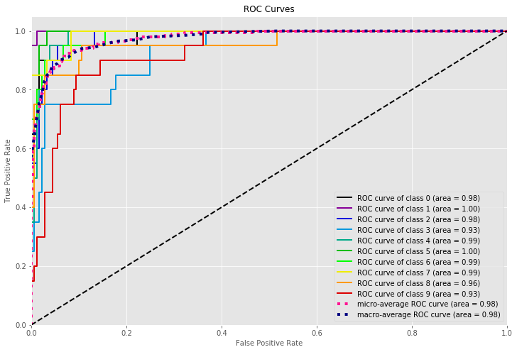
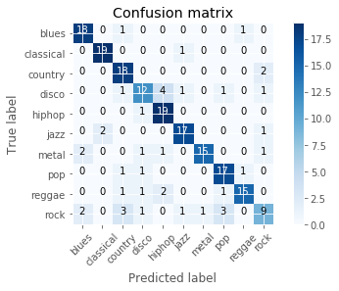
XGBoost Results

Slide 12
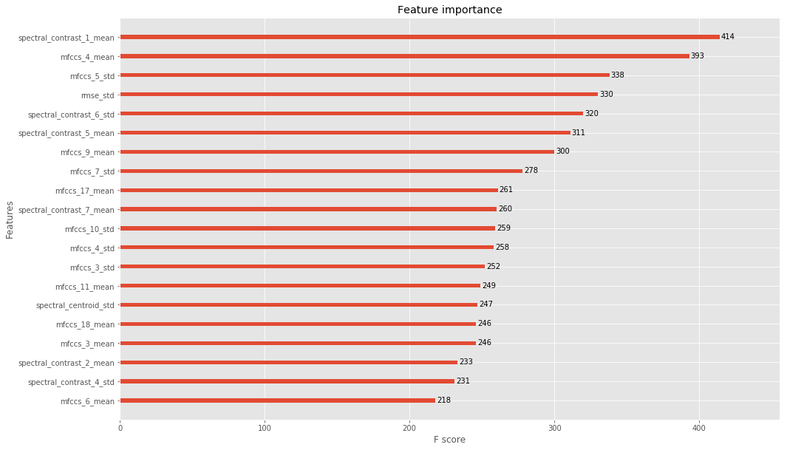
XGBoost Feature Importance

Slide 13
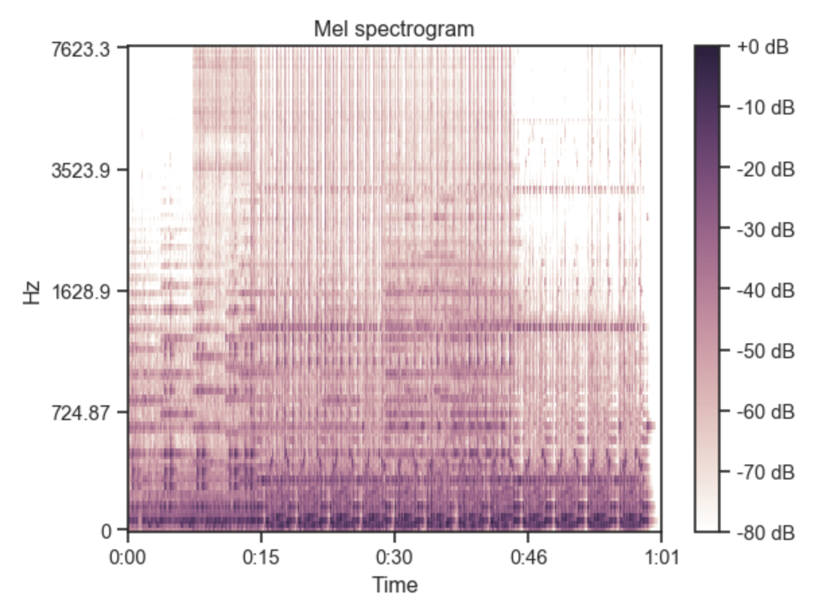
Method II - Spectrogram Analysis
Log-amplitude mel-spectrograms
Maps data to logarithmic scale of decibels for better human perceived hearing spectrum
Parameters used to generate the power spectrogram using STFT are listed below:
Sampling rate (sr) = 22050
Frame/Window size (n fft) = 2048
Time advance between frames (hop size) = 512
Window Function: Hann Window
Frequency Scale: MEL

Slide 14
Classification - CNN
Dataset split - Train (64%), Validation (16%), Test (20%)
5 Convolution Blocks -
ReLU Activation
Max Pooling
Dropout Layer = 0.25
Final layer outputs class probabilities - softmax activation
Loss - Categorical cross entropy
Optimizer - Adam
Metric - Accuracy

Slide 15
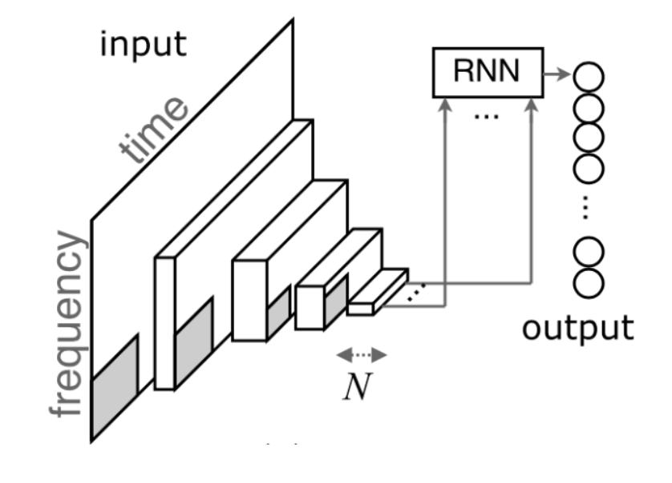
Classification - CRNN
Using combined CNN+RNN structure (CRNN)
CNN : Feature extractor
RNN : Temporal Summariser
Helps to take into account global and local structure
4 Conv Blocks + 2 layer RNN (GRU)
Loss - Categorical cross entropy
Optimizer - Adam
Metric - Accuracy

Slide 16
Results
Classifier | Accuracy | Loss
CNN | 0.838 | 0.508
CRNN | 0.860 | 0.468

Slide 17
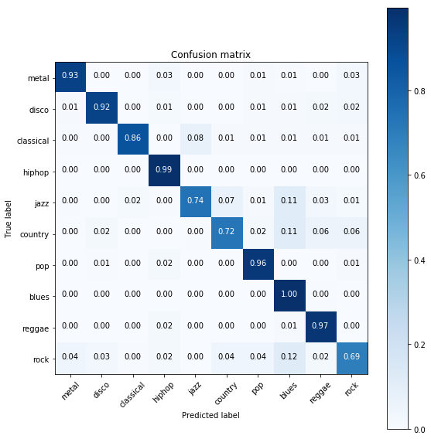
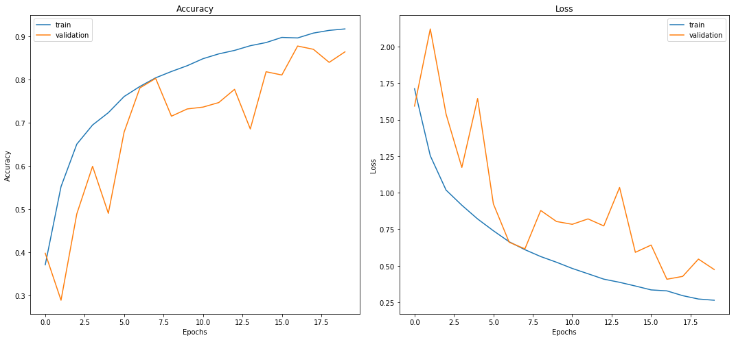
CRNN Results

Slide 18
References
K. Choi, G. Fazekas, M. Sandler and K. Cho , “Convolutional recurrent neural networks for music classification,” IEEE International Conference on Acoustics, Speech and Signal Processing, 2017.
A. J. Goulart, R. C. Guido, C. D. Maciel, “Exploring different approaches for music genre classification,” Egyptian Informatics Journal, 2012.
D. P. Kumar, B. J. Sowmya and K. G. Srinivasa, “A comparative study of classifiers for music genre classification based on feature extractors,” IEEE Distributed Computing, VLSI, Electrical Circuits and Robotics, 2016.
M. Dong, “Convolutional Neural Network Achieves Human-level Accuracy in Music Genre Classification,” arXiv preprint arXiv:1802.09697, 2018.
G. Tzanetakis and P. Cook, “Musical genre classification of audio signals,” IEEE Transactions on speech and audio processing, 2002.

Slide 19
Questions?

